Slide 1
Travel Mate
-By Tanveer Hasan

Slide 2
Project Background
No guideline for tourists
Inconvenience in calculating day wise cost
Hard to keep track of budget
Easy to forget things in excitement
All the tools are not arranged together

Slide 3
Aims
Help tourist remember their events.
Give a short review of their Events.
Help tourist remember any important things.
Get rid of the cost calculations
Make decision of their tour according to weather.
Manage expense according to budget.
Save tourist from getting lost in an unknown place.

Slide 4
Core Feature
Interface to store and view tour details
Make notes for important event
Wallet management
Detect and view the current location
View weather condition and forecast
Suggest nearby places
Direction using Google map
Autologin

Slide 5
Technological Advantage
Material Design
Interactive UI
Shared preference
Better performance with Retrofit 2 (3 times faster)
Backward OS support to Lollypop.

Slide 6

Main interfaces
Splash screen

Slide 7
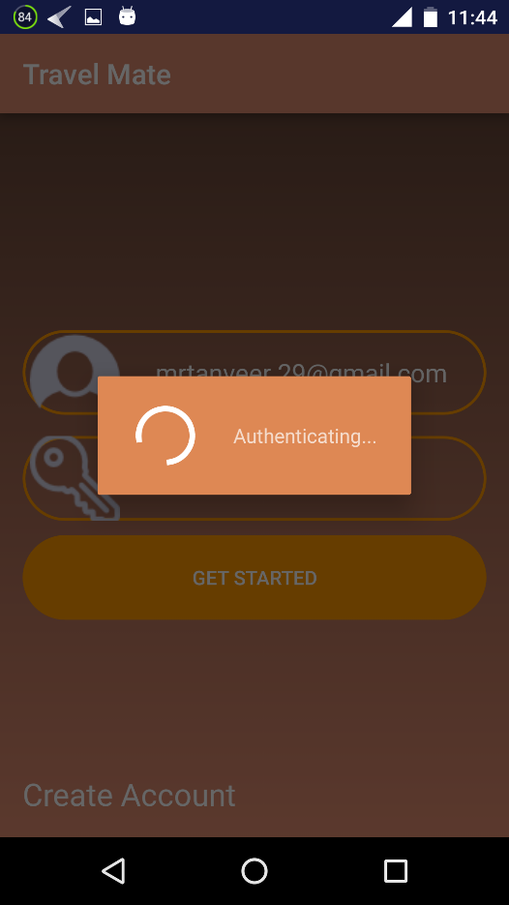
Main interfaces
Authentication with email and password

Slide 8
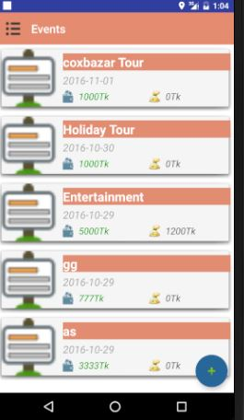
Main interfaces
Event list with details

Slide 9
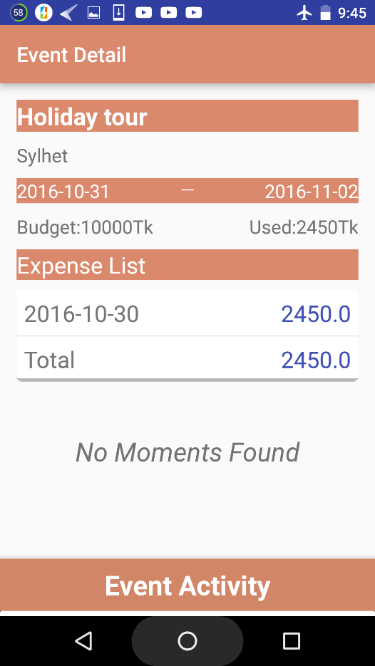
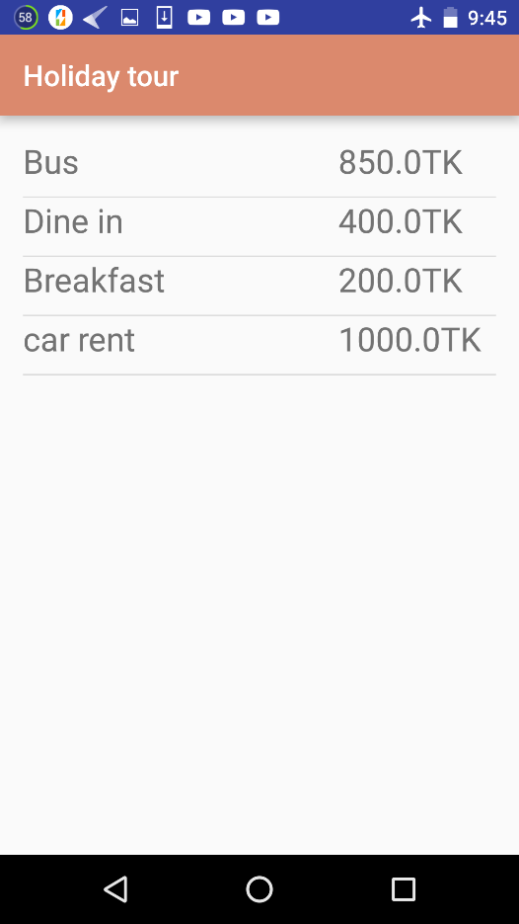
Event details

Slide 10
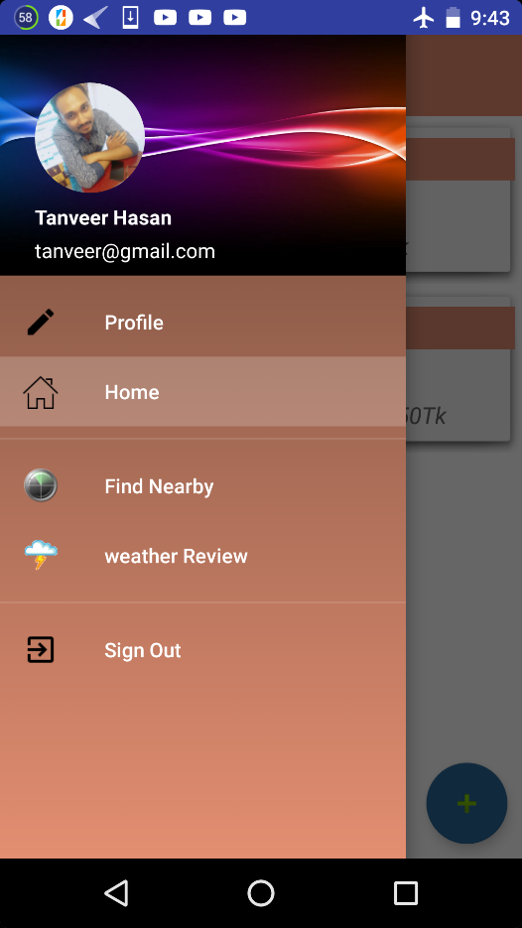
Navigation options

Slide 11
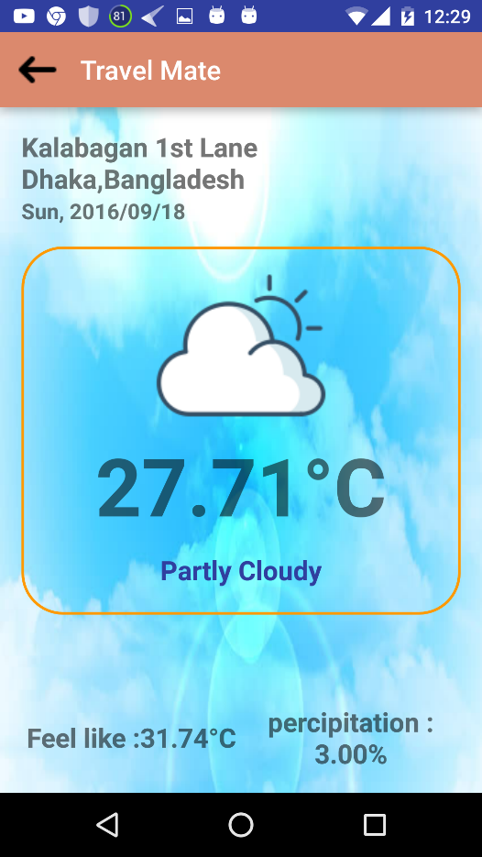
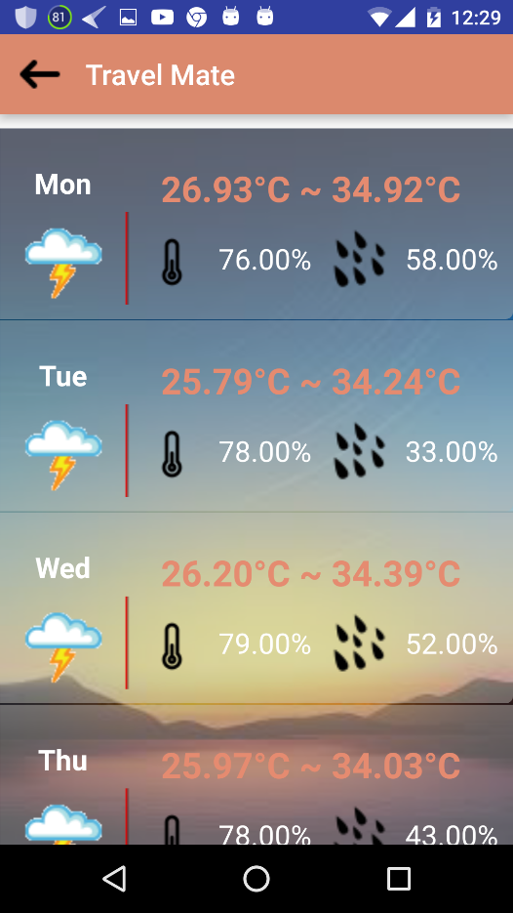
Weather Review

Slide 12
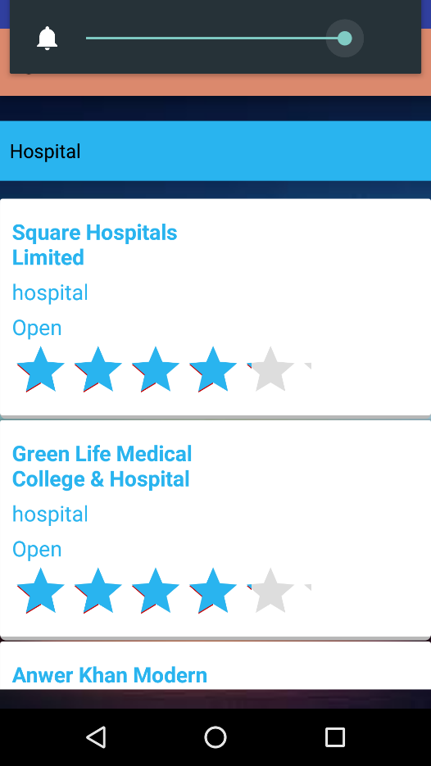
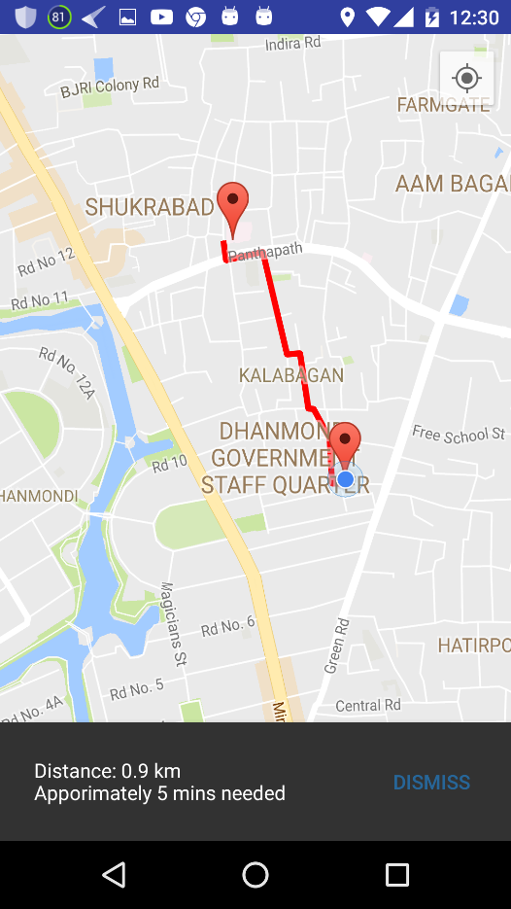
Nearby places

Slide 13
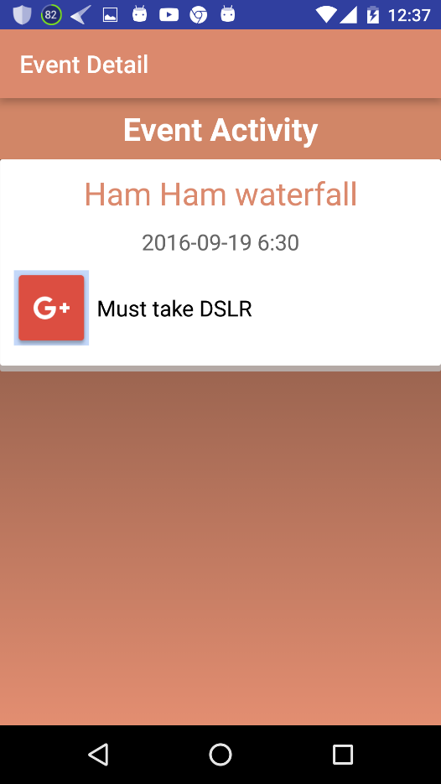
Take notes for event

Slide 14
Future Development
Search for tourist spot
Suggest agency package
Overview of a place
Suggest place based on budget and requirements
Update Graphical user interface

Slide 15
Any Question?

Slide 16

Thank You

